Slide 1
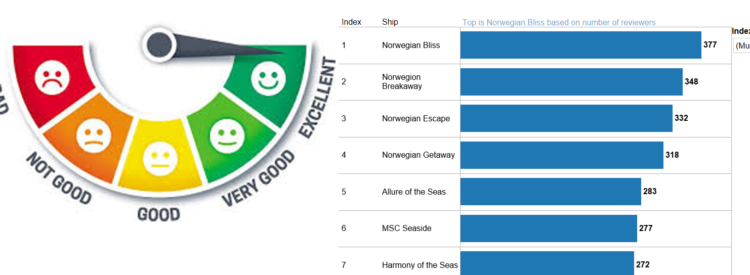

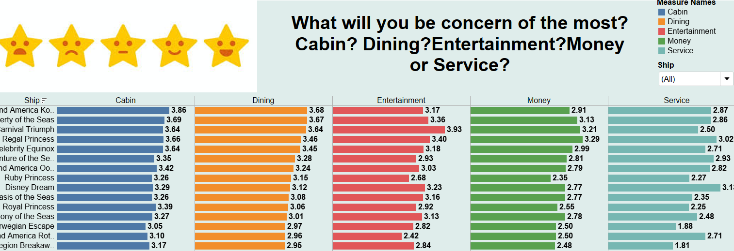
<TripAdvisor data scrapping and analytics Project>
Project Overview
Problem: Using the scrapped data, carry out data analytics to derive hotel guests profiles and build a model to find out which are the key factors (based on the rating data) that different hotel guest profiles are concerned about in their choice of hotels/accommodation (be it high end, mid tier, integrated, boutique, etc).
Requirements:Team is to adopt commonly used data mining methodology and include any data exploration and data cleansing steps
Team is to produce meaningful insights from the data before the analytics using Tableau or any visualization tool as part of data understanding.
Minimally, team must demonstrate data visualization knowledge and skills and exploration of the analytics tool.
Solution: Using the data scraping tool and then collating them, using scraped data and carry out data analytics and derive hotel guests profiles and build model finding out what the guest are concerned for.
Technologies: Parsehub, Tableau
Team Members
Janelle Lim Hui Zhen, Yip Guan Feng
Ten Jing Wen, Jennifer
Mr Tan Lee Kiat (Supervisor)
Notes:
NOTES
Refer to write ups in ‘Past Projects for Reference’ Booklet for Project overview write ups - http://yoda.soi.rp.edu.sg/wiki/index.php/FYP_Wiki
ENGLISH - British E.g. organisation VS organization
Font: RP approved font - Arial family only.
Header: Arial Bold
Copy text: Arial regular or Arial Bold. Use Emphasis of our SOI orange in moderation.
Picture frame – Give a 4.5 or 6pt orange outline.

